Slide 1

Module 3 –In Memory Computation
Spark RDD

Slide 2

How much we understood?
IN MEMORY COMPUTATION-SPARK
What is lineage Graph?
How RDDS are represented?/ what are the important parts of RDD?
How does Shuffling happens in Spark?
Is it ok to perform shuffling in distributed manner ? Does it have any effect on latency?
How does Spark know which key to put on which machine?
Does all transformations are equal?
Which relational algebraic operations are narrow and wide?

Slide 3
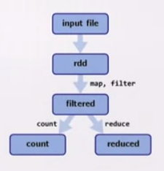
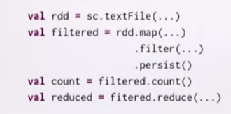
What is Lineage Graph?
IN MEMORY COMPUTATION-SPARK
Group of computations on RDD

Slide 4
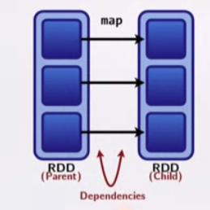
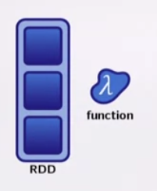
How RDDs are represented?
IN MEMORY COMPUTATION-SPARK
2 parts
Partitions
Dependencies

Slide 5
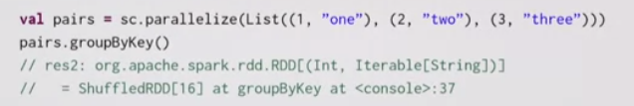
How does shuffling happens in Spark?
IN MEMORY COMPUTATION-SPARK
To do groupbykey in a RDD, needs to move data from one node to another
Major hit on Performance

Slide 6
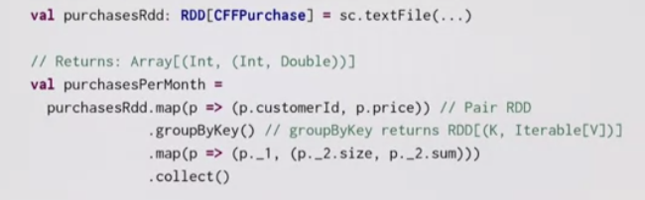
How does shuffling happens in Spark?
IN MEMORY COMPUTATION-SPARK
How many trips and how much money was spent by each individual customer over the course of the month?
Customer id | places | Price
100 | Geneva | 22.25
300 | Zurich | 42.10
100 | Germany | 12.40
200 | Berlin | 13.45
300 | Greece | 10.40

Slide 7
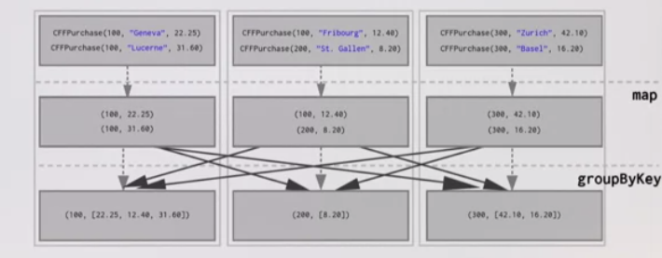
How does shuffling happens in Spark?
IN MEMORY COMPUTATION-SPARK

Slide 8
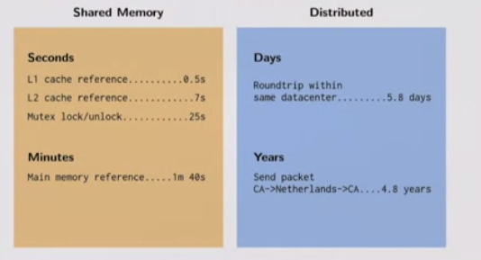
IN MEMORY COMPUTATION IN SPARK
Why Shuffling is Bad?
Sending data over the
Network is bad

Slide 9
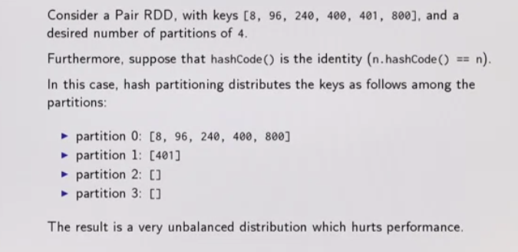
IN MEMORY COMPUTATION IN SPARK
How does spark know which key to put on each machine?

Slide 10
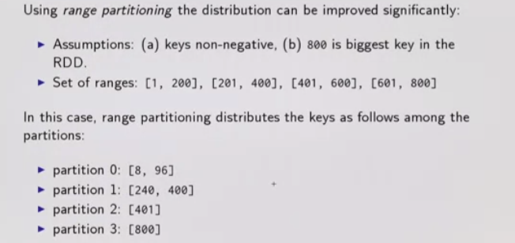
IN MEMORY COMPUTATION IN SPARK
How does spark know which key to put on each machine?

Slide 11
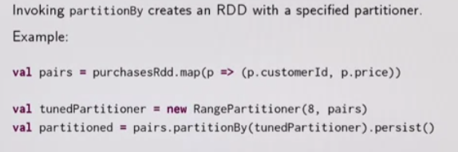
IN MEMORY COMPUTATION IN SPARK
How do we set partitioning to our data?

Slide 12
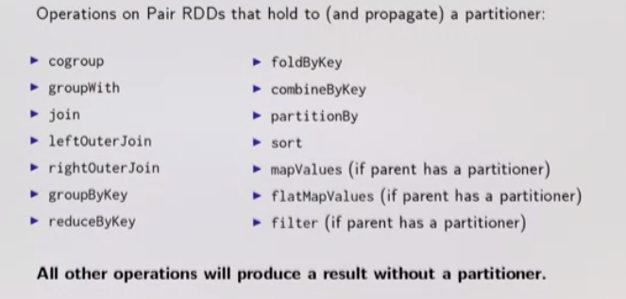
IN MEMORY COMPUTATION IN SPARK
How do we set partitioning to our data?

Slide 13
IN MEMORY COMPUTATION IN SPARK
Does all transformations are equal?
Rule of thumb for Shuffle:
When the resulting RDD depends on other elements from the same RDD or another RDD
Parent
Child
Child
Child
Transformations causes shuffles
Narrow dependencies
Wide Dependencies
Parent
Child
Narrow-Fast
Wide-Slow

Slide 14
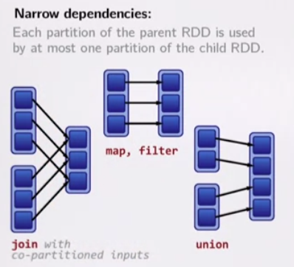
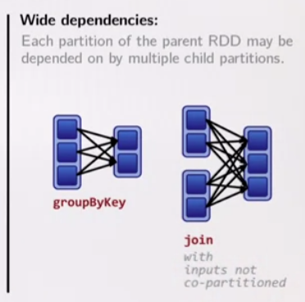
IN MEMORY COMPUTATION IN SPARK
Does all transformations are equal?

Slide 15
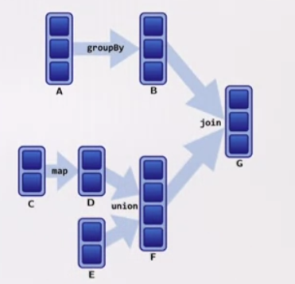
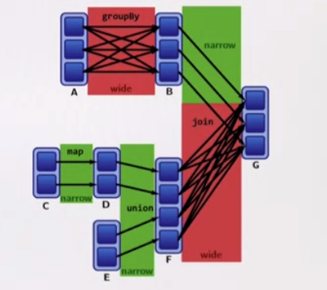
IN MEMORY COMPUTATION IN SPARK
Can you tell me which has wide and which one has narrow dependencies?

Slide 16
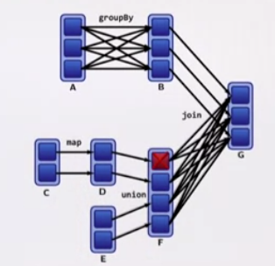
IN MEMORY COMPUTATION IN SPARK
Can you tell me which has wide and which one has narrow dependencies?
Recomputing
Narrow-Fast
Wide-Slow

Slide 17
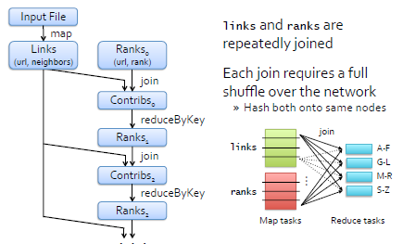
IN MEMORY COMPUTATION IN SPARK
Did you all understand page rank program in spark?
lines = textfile (“urls.txt”))
links = lines.map (lambda urls: urls.split()).groupByKey().cache()
ranks = links.map(lambda url_neighbors: (url_neighbors[0], 1.0))
for iteration in range(MAXITER)):
contribs = links.join(ranks).flatMap( lambda url_neighbors_rank: computeContribs (url_neighbors_rank)
ranks = contribs.reduceByKey(add).mapValues(lambda rank: rank * 0.85 + 0.15)

Slide 18
BIG DATA
Exercise
Based on the sample of the Filter RDD, can you work out what will be the partitions, compute, dependencies, preferred locations and partitioner for a joinRDD
Filtered RDD (as in sample application)
Partitions – same as parent
Dependencies – 1-1 with parent
Compute – compute parent and filter it.
Preferred locations – ask parent (none)
Partitioner - none

Slide 19
BIG DATA
Examples of RDDs
Joined RDD
RDDPartitions – one per reduce task
Dependencies – shuffle on each parent
Compute (partition) – read and join shuffled data
Preferred locations – none
Partitioner – HashPartioner (num tasks)
Notes:
Result of a join could be suggested to be grouped in specific number of groups/buckets – as decided by user. This can be considered as individual reduce task for the Partitions.
Consider – links RDD for url neighbors list is having 1000 partitions and ranks RDD for urls has 100 partitions.
User can specify the join operation on these two RDDs to result in 10 buckets or partitions – grouped based on region.
Shuffle on each joined RDD is necessary as the resulting RDD can be there in any of the 10 buckets.

Slide 20
Spark Scheduling

Slide 21
BIG DATA
DAG representation of Page Rank
Spark supports two types of partitioning – hash and range

Slide 22
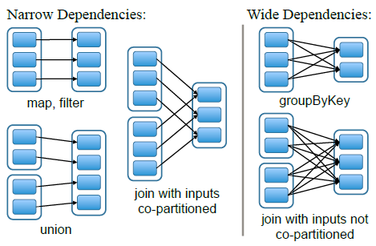
BIG DATA
Functional Programming
narrow dependencies
where each partition of the parent RDD is used by at most one partition of the child RDD
Does not need a shuffle; pipeline operations
Shuffle: movement of data from one node to another
wide dependencies
where multiple child partitions may depend on it.
May need a shuffle
Copartition → technique to make sure that both inputs to a join are partitioned using same function

Slide 23
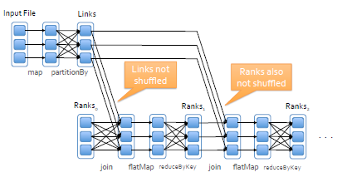
BIG DATA
Lineage and Optimizing Placement
links & ranks repeatedly joined
Can co­partition them (e.g.hash both on URL) to avoid shuffles
Spark supports two types of partitioning: hash and range
lines = textfile (“urls.txt”))
links = lines.map (lambda urls: urls.split()).groupByKey().cache()
ranks = links.map(lambda url_neighbors: (url_neighbors[0], 1.0))
for iteration in range(MAXITER)):
contribs = links.join(ranks).flatMap( lambda url_neighbors_rank: computeContribs (url_neighbors_rank)
ranks = contribs.reduceByKey(add).mapValues(lambda rank: rank * 0.85 + 0.15)

Slide 24
BIG DATA
Narrow and Wide Dependencies
Narrow Dependencies
W i d e Dependencies
Map
FlatMap
MapPartitions
Filter
Sample
Union
Intersection
Distinct
ReduceByKey
GroupByKey
Join
Cartesian
Repartition
Coalesce

Slide 25
BIG DATA
Scheduling
Breakup DAG into stages at shuffle boundaries. Within stage computation is local

Slide 26
BIG DATA
Task Assignment
scheduler assigns tasks to machines based on data locality using delay scheduling
if a task needs to process a partition that is available in
memory on a node, then send it to that node
otherwise, a task processes a partition for which the containing RDD provides preferred locations (e.g., an HDFS file), then send it to those
A:
B:
G:
Stage 1
groupBy
C:
D:
F:
map
E:
join
Stage 2
union
Stage 3

Slide 27
THANK YOU

